Slide 1

Chino Valley Fire Districting Public Meeting #5 March 9, 2022

Slide 2
Tonight’s Public Meeting
Final public meeting
Review of revised draft maps
Selection of final map and potential passage of resolution
Next Steps

Slide 3
Districting Process
Step | Description
Initial Pre-Draft Hearing(s) November 17 and December 8 | Held prior to release of draft maps. Education and to solicit input on the communities in the District.
Release draft maps | Draft maps posted to project website
Two hearings on draft maps January 12 and February 9 | Two meetings to discuss and revise the draft maps and to discuss the election sequence.
Map adoption March 9 | Map adopted via resolution. Final map must be posted at least 7 days prior to adoption.

Slide 4

Redistricting Rules and Goals
Federal Laws
Traditional Redistricting Principles
Equal Population
Federal Voting Rights Act
No Racial Gerrymandering
Communities of interest
Compact
Contiguous
Visible (Natural & man-made) boundaries
Respect voters’ choices / continuity in office
Planned future growth

Slide 5
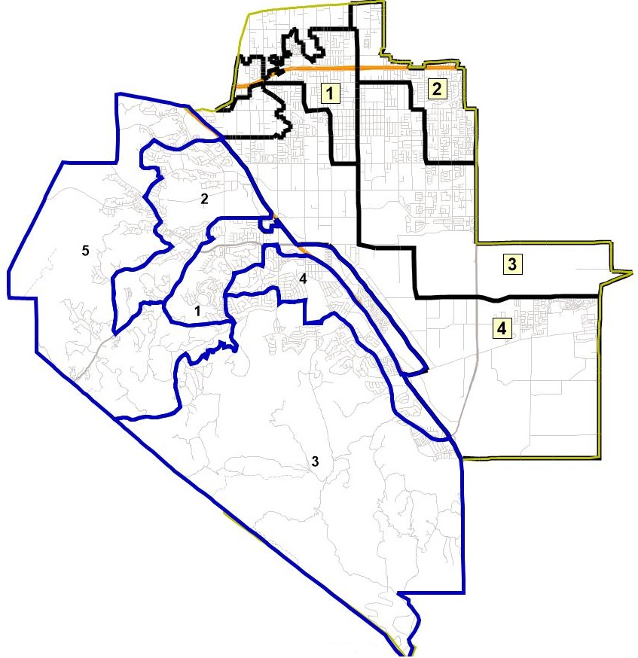
District Boundaries with City Overlay
Map to right shows CVIFD’s service area with the City of Chino’s districts in black and the City of Chino Hills’ districts in blue

Slide 6
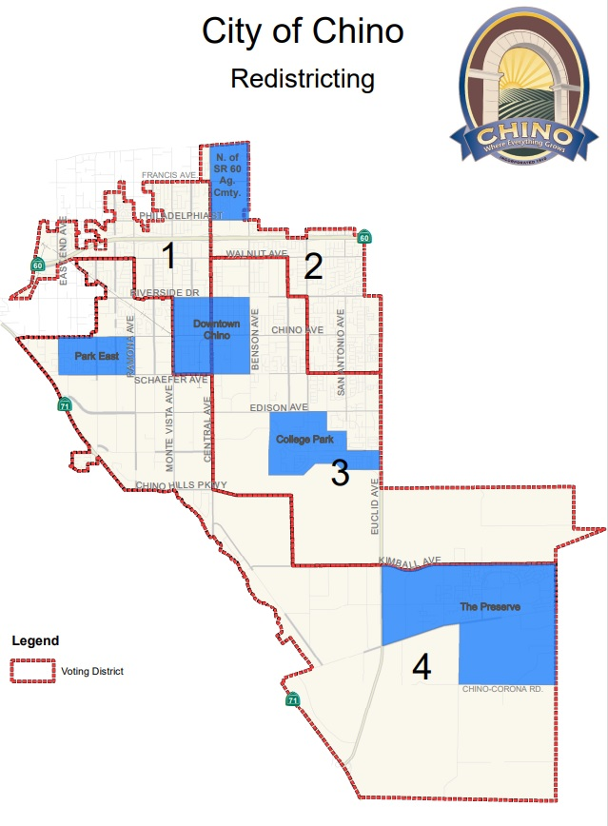
Chino’s Defined Communities of Interest

Slide 7
Timeline & Next Steps
Around October 1, 2021 | Redistricting data available. Census data was released in mid- to late-August. California released prisoner-adjusted redistricting data around October 1.
November 17, 2021 | 1st Public Hearing Held prior to the release of draft maps
December 8, 2021 | 2nd Public Hearing
January 12, 2022 | 3rd hearing to discuss and revise draft maps
February 9, 2022 | Proposed 4th hearing to discuss draft maps
February 2022 (tentative) | Publish revised map(s)
March 9, 2022 | Final Public Meeting and Board to adopt District map.
April 17, 2022 | Deadline to submit final map to SB County Registrar of Voters
November 2022 | 2022 Election

Slide 8
Remainder of Tonight’s Session
Questions regarding the presentation?
Provide feedback on proposed maps
Potentially consider moving forward a resolution to approve map

Slide 9
https://arcg.is/e95jG0

