Slide 1

Chino Valley Fire Districting Hearing #3 January 12, 2022

Slide 2
Tonight’s Public Hearing
The 2022 districting process
Review of draft maps
Provide feedback on proposed maps
Key deadlines
Next steps and hearings

Slide 3
Districting Process
Step | Description
Initial Pre-Draft Hearing(s) November 17 and December 8 | Held prior to release of draft maps. Education and to solicit input on the communities in the District.
Release draft maps | Draft maps posted to project website
Two hearings on draft maps January 12 and February 9 | Two meetings to discuss and revise the draft maps and to discuss the election sequence.
Map adoption March 9 | Map adopted via ordinance/resolution. Final map must be posted at least 3/7 days prior to adoption.

Slide 4
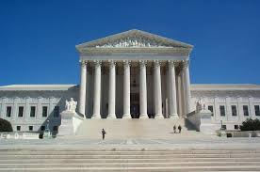
Redistricting Rules and Goals
Federal Laws
Traditional Redistricting Principles
Equal Population
Federal Voting Rights Act
No Racial Gerrymandering
Communities of interest
Compact
Contiguous
Visible (Natural & man-made) boundaries
Respect voters’ choices / continuity in office
Planned future growth
Minimize voters shifted to different election years
Preserving the core of existing election areas

Slide 5
CVIFD Demographic Stats
Chino Valley Independent Fire District
2020 Demographic Data
Category | Field | Count | Pct
Total Pop | 2020 Census Pop. | 170,710
 | Hisp | 70,670 | 41.40%
 | NH White | 37,081 | 21.72%
 | NH Black | 7,921 | 4.64%
 | Asian-American | 51,154 | 29.97%
Citizen Voting Age Pop | Total | 111,661
 | Hisp | 42,608 | 38.16%
 | NH White | 36,335 | 32.54%
 | NH Black | 5,546 | 4.97%
 | Asian/Pac.Isl. | 25,593 | 22.92%
Voter Registration (Nov 2020) | Total | 96,630
 | Latino est. | 38,005 | 39.33%
 | Spanish-Surnamed | 34,601 | 35.81%
 | Asian-Surnamed | 13,172 | 13.63%
 | Filipino-Surnamed | 3,101 | 3.21%
 | NH White est. | 40,101 | 41.50%
 | NH Black | 4,726 | 4.89%
Voter Turnout (Nov 2020) | Total | 79,743
 | Latino est. | 30,468 | 38.21%
 | Spanish-Surnamed | 27,818 | 34.88%
 | Asian-Surnamed | 10,446 | 13.10%
 | Filipino-Surnamed | 2,622 | 3.29%
 | NH White est. | 34,058 | 42.71%
 | NH Black | 3,944 | 4.95%
Voter Turnout (Nov 2018) | Total | 51,045
 | Latino est. | 18,299 | 35.85%
 | Spanish-Surnamed | 16,872 | 33.05%
 | Asian-Surnamed | 4,757 | 9.32%
 | Filipino-Surnamed | 1,470 | 2.88%
 | NH White est. | 24,673 | 48.34%
 | NH Black est. | 2,567 | 5.03%

Slide 6
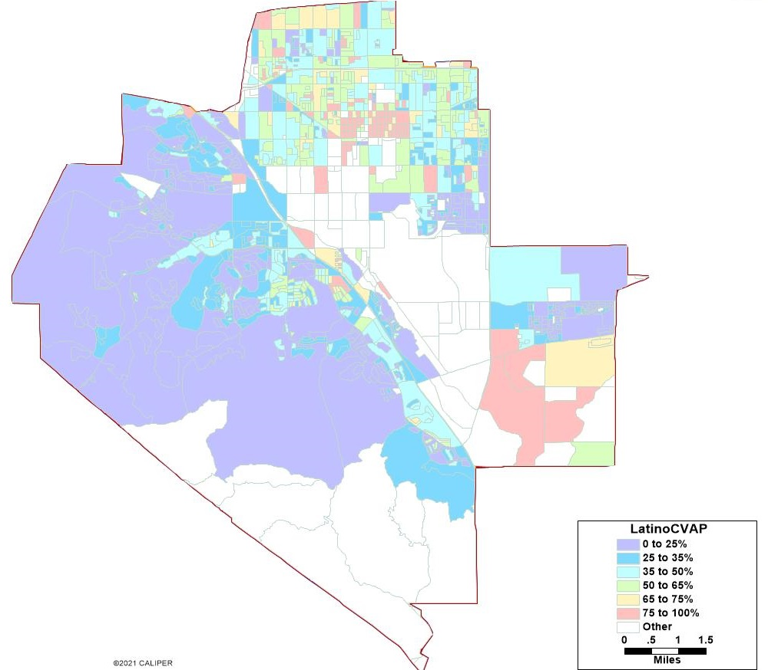
Latino CVAP

Slide 7
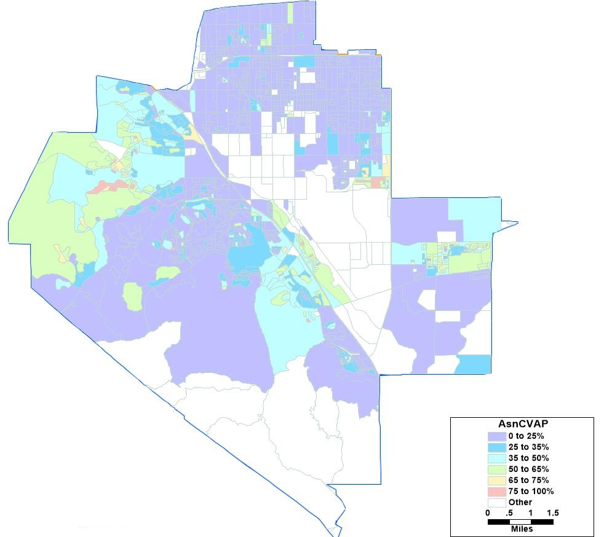
Asian American CVAP

Slide 8
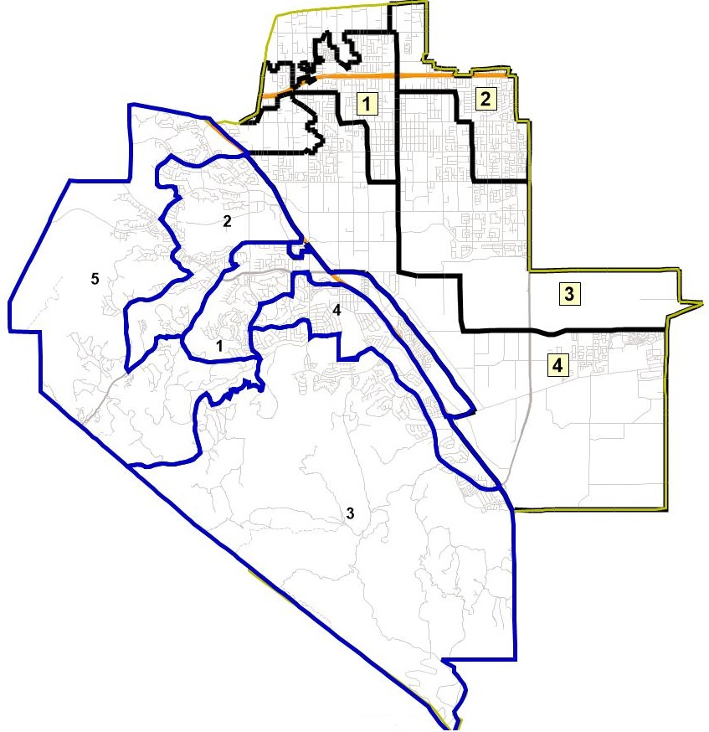
District Boundaries with City Overlay
Map to right shows CVIFD’s service area with the City of Chino’s districts in black and the City of Chino Hills’ districts in blue

Slide 9
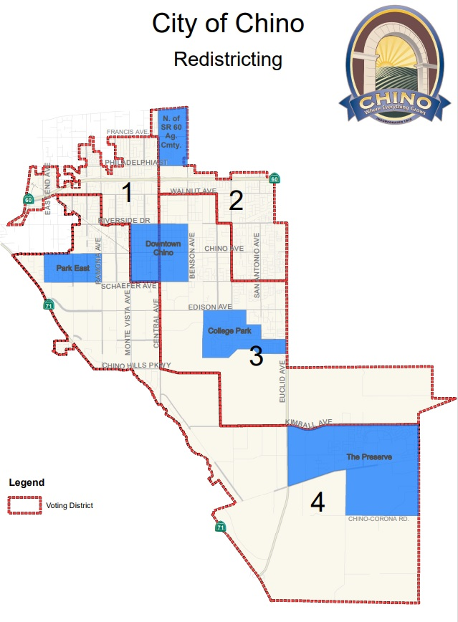
Chino’s Defined Communities of Interest

Slide 10
Timeline & Next Steps
Around October 1, 2021 | Redistricting data available. Census data was released in mid- to late-August. California released prisoner-adjusted redistricting data around October 1.
November 17, 2021 | 1st Public Hearing Held prior to the release of draft maps
December 8, 2021 | 2nd Public Hearing
January 12, 2022 | 3rd hearing to discuss and revise draft maps
February 9, 2022 | Proposed 4th hearing to discuss draft maps
February 2022 (tentative) | Publish revised map(s)
March 9, 2022 | Final Hearing and Board to adopt District map.
April 17, 2022 | Deadline to submit final map to SB County Registrar of Voters
November 2022 | 2022 Election

Slide 11
Remainder of Tonight’s Session
Questions regarding the presentation?
Review of draft maps
Provide feedback on proposed maps

Slide 12
https://www.arcgis.com/home/webmap/viewer.html?webmap=feb258024e81436584033b549888e338&extent=-117.8852,33.8706,-117.4808,34.0517

