Slide 1

Chino Valley Fire Districting Hearing #1 November 17, 2021

Slide 2
2021 CVIFD Districting
The 2021 districting process
Why is Chino Valley Fire considering the voluntary transition to by-division elections?
Project timelines
Key deadlines
Next steps and hearings

Slide 3
Election Systems
From “at-large” voting
To “by-District/Division” or “Residence” Districts
The California Voting Rights Act was written to specifically encourage by-district/division elections.

Slide 4
California Voting Rights Act (CVRA)
Under the Federal Voting Rights Act (passed in 1965), a jurisdiction must fail 4 factual tests before it is in violation of the law.
The California VRA makes it significantly easier for plaintiffs to force jurisdictions into “by-district” election systems by eliminating two of the US Supreme Court Gingles tests:
Can the protected class constitute the majority of a district?
Does the protected class vote as a bloc?
Do the voters who are not in the protected class vote in a bloc to defeat the preferred candidates of the protected class?
Do the “totality of circumstances” indicate race is a factor in elections?
Liability is now determined only by the presence of racially polarized voting

Slide 5
CVRA Impact
Switched (or in the process of switching) as a result of CVRA:
At least 240 school districts
34 Community College Districts
154 cities
1 County Board of Supervisors
35 water and other special districts.
Cases So Far:
Palmdale, Santa Clara and Santa Monica went to trial on the merits. Palmdale and Santa Clara lost. Santa Monica is awaiting a decision.
Modesto and Palmdale each spent about $1.8 million on their defense (in addition to the attorney fee awards in those cases).
Santa Monica has spent an estimated $7 million so far. Plaintiffs in Santa Monica requested $22 million in legal fees after the original trial.
Key settlements:
Palmdale: $4.7 million
Modesto: $3 million
Highland: $1.3 million
Anaheim: $1.1 million
Whittier: $1 million
Santa Barbara: $600,000
Tulare Hospital: $500,000
Camarillo: $233,000
Compton Unified: $200,000
Madera Unified: about $170,000
Hanford Joint Union Schools: $118,000
Merced City: $42,000
An estimated $16 million in total settlements and court awards so far.

Slide 6
Districting Process
Step | Description
Initial Pre-Draft Hearing(s) November 17 and December 8 | Held prior to release of draft maps. Education and to solicit input on the communities in the District.
Initial deadline for draft maps | Deadline for the public to submit draft maps for inclusion in the next hearing packet and presentation
Release draft maps | Draft maps posted to project website
Two hearings on draft maps January 12 and February 9 | Two meetings to discuss and revise the draft maps and to discuss the election sequence.
Map adoption March 9 | Map adopted via ordinance/resolution. Final map must be posted at least 3/7 days prior to adoption.

Slide 7
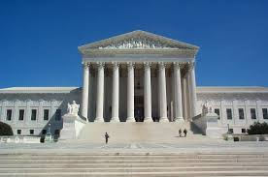
Redistricting Rules and Goals
Federal Laws
Traditional Redistricting Principles
Equal Population
Federal Voting Rights Act
No Racial Gerrymandering
Communities of interest
Compact
Contiguous
Visible (Natural & man-made) boundaries
Respect voters’ choices / continuity in office
Planned future growth
Minimize voters shifted to different election years
Preserving the core of existing election areas

Slide 8
CVIFD Demographic Stats
Chino Valley Independent Fire District
2020 Demographic Data
Category | Field | Count | Pct
Total Pop | 2020 Census Pop. | 170,710
 | Hisp | 70,670 | 41.40%
 | NH White | 37,081 | 21.72%
 | NH Black | 7,921 | 4.64%
 | Asian-American | 51,154 | 29.97%
Citizen Voting Age Pop | Total | 111,661
 | Hisp | 42,608 | 38.16%
 | NH White | 36,335 | 32.54%
 | NH Black | 5,546 | 4.97%
 | Asian/Pac.Isl. | 25,593 | 22.92%
Voter Registration (Nov 2020) | Total | 96,630
 | Latino est. | 38,005 | 39.33%
 | Spanish-Surnamed | 34,601 | 35.81%
 | Asian-Surnamed | 13,172 | 13.63%
 | Filipino-Surnamed | 3,101 | 3.21%
 | NH White est. | 40,101 | 41.50%
 | NH Black | 4,726 | 4.89%
Voter Turnout (Nov 2020) | Total | 79,743
 | Latino est. | 30,468 | 38.21%
 | Spanish-Surnamed | 27,818 | 34.88%
 | Asian-Surnamed | 10,446 | 13.10%
 | Filipino-Surnamed | 2,622 | 3.29%
 | NH White est. | 34,058 | 42.71%
 | NH Black | 3,944 | 4.95%
Voter Turnout (Nov 2018) | Total | 51,045
 | Latino est. | 18,299 | 35.85%
 | Spanish-Surnamed | 16,872 | 33.05%
 | Asian-Surnamed | 4,757 | 9.32%
 | Filipino-Surnamed | 1,470 | 2.88%
 | NH White est. | 24,673 | 48.34%
 | NH Black est. | 2,567 | 5.03%

Slide 9
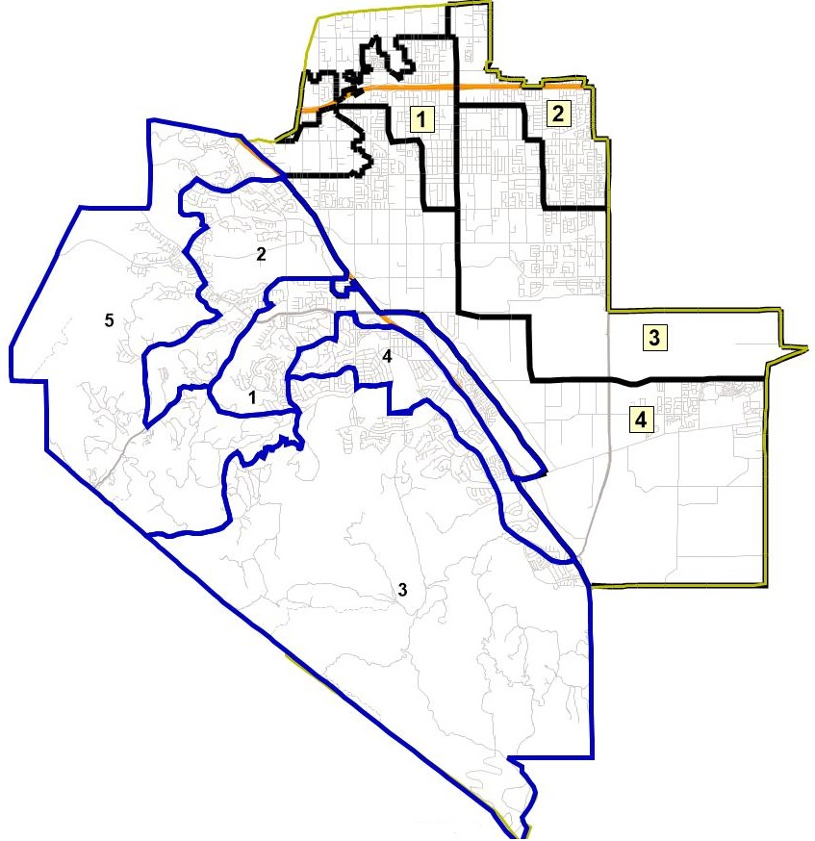
District Boundaries with City Overlay
Map to right shows CVIFD’s service area with the City of Chino’s districts in black and the City of Chino Hills’ districts in blue

Slide 10
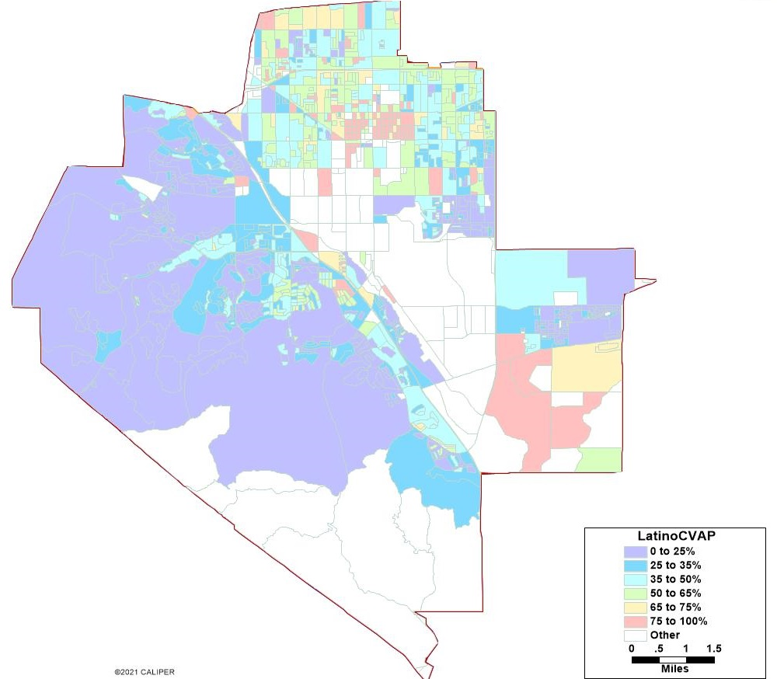
Latino CVAP

Slide 11
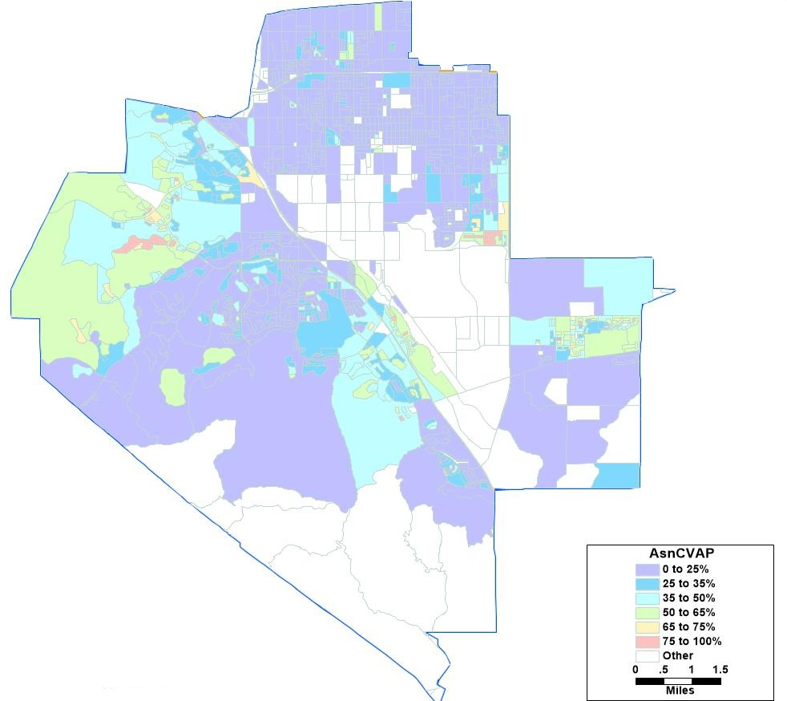
Asian American CVAP

Slide 12
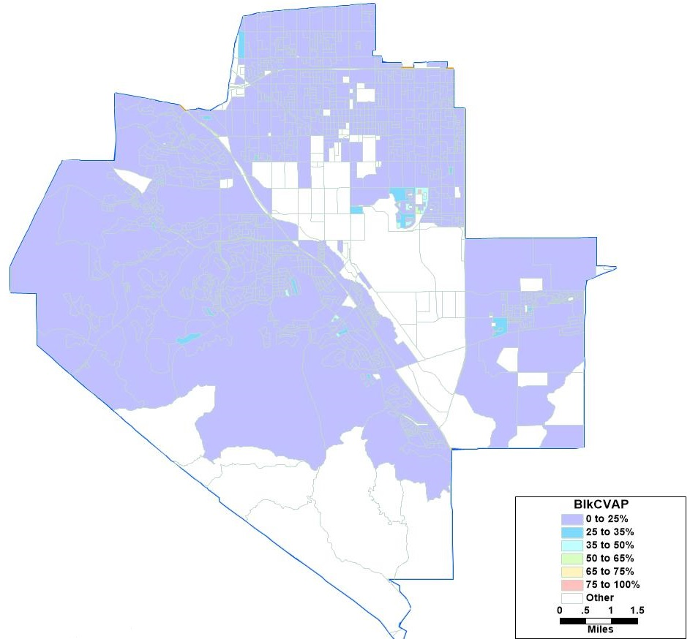
African American CVAP

Slide 13
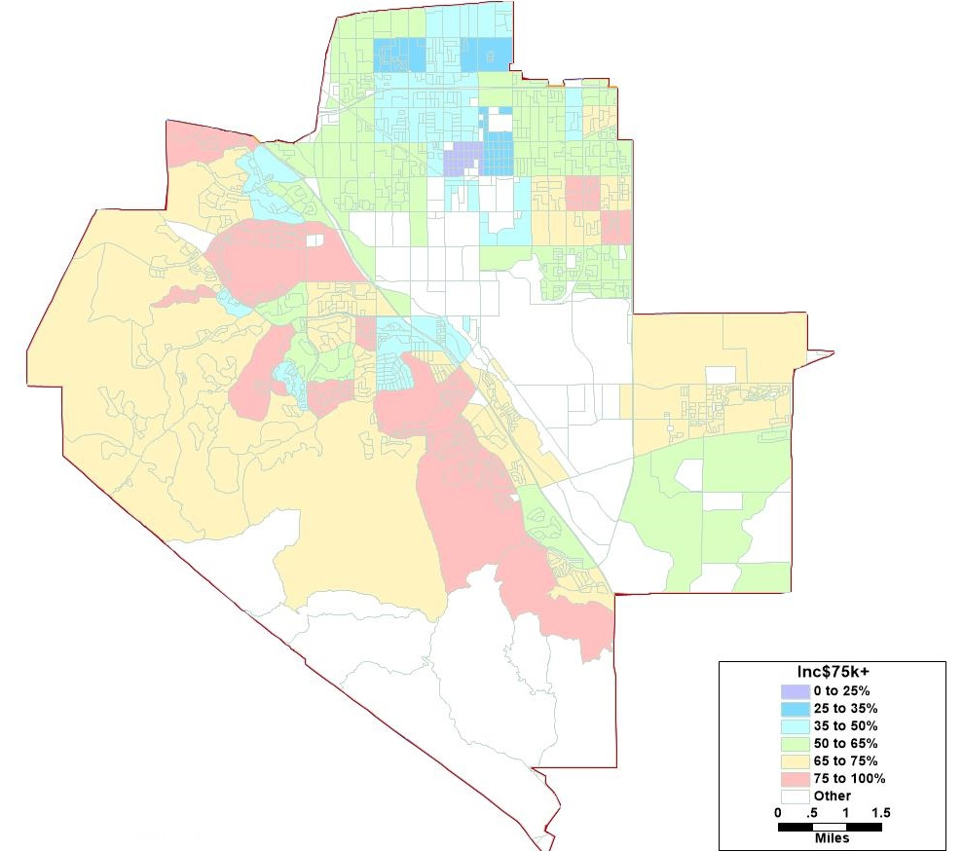
Income Statistics

Slide 14
Timeline & Next Steps
Due to delays in the release of the Census data, the full data sets from the Census Bureau was not ready until late September
NDC will seek public input for potential district maps as well as feedback from the Board

Slide 15
Timeline & Next Steps
Fall 2021 | Mapping software released to the public.* *Estimated time
Around October 1, 2021 | Redistricting data available. Census data was released in mid- to late-August. California released prisoner-adjusted redistricting data around October 1.
November 17, 2021 | 1st Public Hearing Held prior to the release of draft maps
December 8, 2021 | 2nd Public Hearing
January 2022 | Maps and comments due from public
January 12, 2022 | Proposed 3rd hearing
February 9, 2022 | Proposed 4th hearing.
February 2022 (tentative) | Publish revised map(s)
March 9, 2022 | Final Hearing and Board to adopt District map.
April 17, 2022 | Deadline to submit final map to SB County Registrar of Voters
November 2022 | 2022 Election

